Slide 1
HCI Evaluation Studies
Part 2: User Studies
Compsci 705 / Soft Eng 702

Slide 2
Today
Planning the study
  Task design
  Bias
  Questionnaires
  Recruiting participants
Piloting
Performing the study
Collecting and analysing results
  Statistical analysis
Reporting

Slide 3
Usability Studies
Evaluating a single piece of software in isolation.
Usually you ask users to complete specific tasks.
You can then calculate metrics like:
  Time
  Success rate
  Number of attempts needed to succeed
  Enjoyability
Importantly, you get to observe people using the software

Slide 4
Comparative Studies
Comparing two (or more) pieces of software.
Considerably more challenging!
Needs to be a fair test.
  How can you be sure that an effect isn’t just due to the task ordering, or the users’ experience with doing the task?

Slide 5
Planning a Study
You need to do lots of planning.
Write up a proposal – this will help you get your thoughts straight, and it provides material that can go into your ethics application and even your report/thesis.
  See http://www.cs.auckland.ac.nz/courses/compsci705s1c/lectures/UsabilityTestingTemplate.doc
Types of questions you need to answer
  Where will you conduct the study? Does it matter?
  What hardware/software do you need?

Slide 6
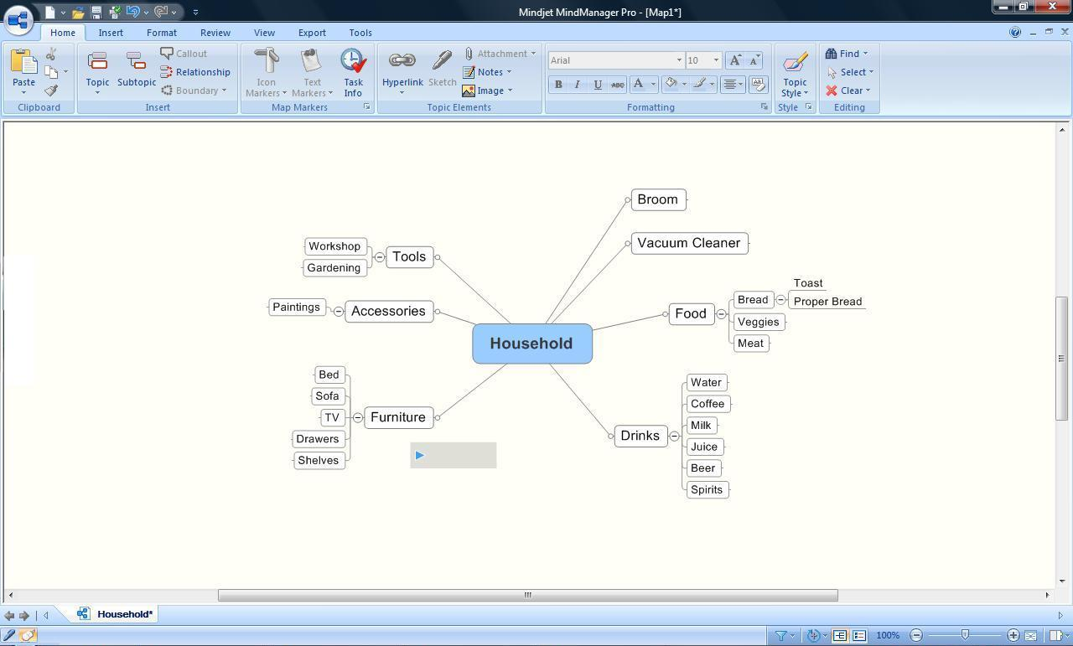
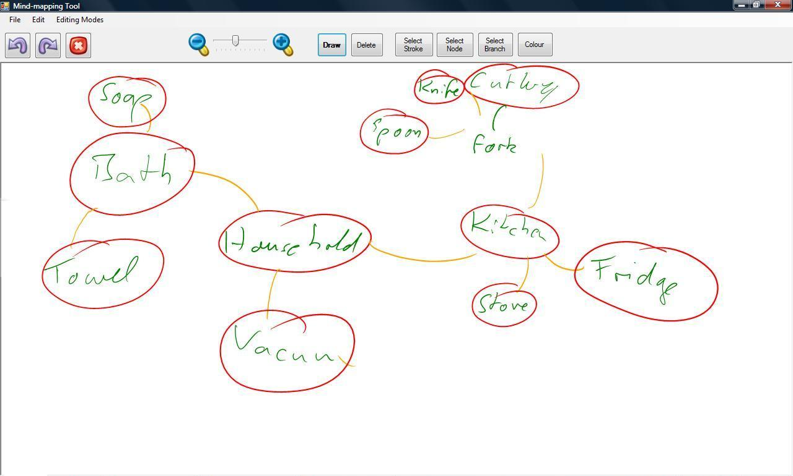
Example Study
We want to compare two tools:
  A commercial widget-based tool for mind mapping, and
  A sketch-based tool to do a similar task.

Slide 7
Planning a Study
What’s your hypothesis?
  That tool X is better than tool Y?
  That tool X takes less time to learn than tool Y?
What are you measuring?
  How do you define ‘better’?
  Time? Error rate? Satisfaction?
  Are these subjective or objective measures?

Slide 8
Planning a Study
Design your tasks.
  What will you ask users to do?
Write a script.
  Specify exactly how users can achieve the task, and exactly how you will measure their performance.

Slide 9

Designing Tasks
Task 1: Add centre noed
Please add a central node to the mind map.
Setup required: none.
Measures:
Boolean specifying whether the user successfully completed the task.
Time (in seconds) from when the instruction is completed to when the user successfully inserts the central node.

Slide 10
Designing Tasks
How do you fairly compare two systems?
  Give users tasks to do on each system.
  How do we know the tasks are equivalent?
  How do we stop the second time around being too easy?
Is this a problem with all comparative studies?

Slide 11
Designing Tasks
Ways to achieve similarity:
  Same structure, different content
  Same content, different structure
  Think creatively – use textbook problems
  Keep things simple
  Pilot...

Slide 12
Avoiding Bias
Bias: something about the methodology or analysis makes it an unfair test.
Sources of bias in HCI evaluations?
  Experimenter effects: ‘pushing’ users to respond the way you want, or analysing data the way you want it to turn out (maybe inadvertently)
  Participant/self-selection biases: most experiments are done on first year psychology students...
  Task order effects: will the user have more knowledge by the time they get to task 2?

Slide 13
Avoiding Bias
How can you avoid bias?
  Randomly assign users to conditions (use Excel’s =rand()... or dice).
  Use a script – and stick to it.

Slide 14
Planning a Study
What about subjective measures?
  How much did you enjoy using this application?
  Which would you prefer to use again?
  Demographics?
Questionnaires are often the easiest way to get this information.
  Be careful – don’t overload yourself with data.

Slide 15
Questionnaires
Will you construct your own questionnaire?
Will you use a standardised questionnaire (e.g. the System Usability Scale?)
Brooke, J. (1996). "SUS: a "quick and dirty" usability scale". in P. W. Jordan, B. Thomas, B. A. Weerdmeester, & A. L. McClelland. Usability Evaluation in Industry. London: Taylor and Francis.
1. I think that I would like to use this system frequently.
2. I found the system unnecessarily complex.
3. I thought the system was easy to use.
4. I think that I would need the support of a technical person to be able to use this system.
5. I found the various functions in this system were well integrated.
6. I thought there was too much inconsistency in this system.
7. I would imagine that most people would learn to use this system very quickly.
8. I found the system very cumbersome to use.
9. I felt very confident using the system.
10. I needed to learn a lot of things before I could get going with this system.

Slide 16
Questionnaires
What information will you collect?
Why?
How will you collect it?
  Booleans (agree/disagree, yes/no)
  Likert scales (1-4, 1-5, 1-7)
  Free text fields
    How do you analyse this?
When will you ask for this information?
  Before the user starts? Half way through? At the end?

Slide 17
Questionnaires
How will you deliver your questionnaire?
  Morae?
  Paper form?
How will the form be designed?
  Pilot this as well!
  Don’t want to confuse the participant.
  Be careful with scales.
  Probably needs to be in the ethics application too.
  Use question IDs if you have lots of participants.

Slide 18
Questionnaires
How will you code the information?
  Morae: you don’t need to.
  Paper form: type in all the data?
How will you analyse?
  Which statistics will you calculate?
  What effects do you expect?

Slide 19
Getting Participants
Work out the type and number of participants you need.
  Usability studies: depends!
    4 x 2 is a good
    Do 4, analyse problems and correct most frequent problems
    Do another 4 – correct any further major problems.
  Comparative studies: need to have enough for each permutation of task and system.
Condition | Task 1 |  | Task 2
 | Task | Application | Task | Application
1 | Animals | Sketch | Household Items | Widget
2 | Household Items | Sketch | Animals | Widget
3 | Animals | Widget | Household Items | Sketch
4 | Household Items | Widget | Animals | Sketch

Slide 20
Getting Participants
How will you find participants?
  This will be important for the ethics application too.
  Where will you advertise?
  Who are you looking for?
  Does age/background/gender/experience matter?

Slide 21
Piloting
This is more important than you think.
In a crunch, just pilot with one participant. If possible, do 2-3 pilot studies.
Make software and study design changes as you need to.
  Try to get most of these done before the study begins.
  You can sometimes make changes during a study too, but check with your supervisor.

Slide 22
Performing the Study
Perform the study with the participants.
  Follow the plan – keep things as consistent as possible. This is extremely important for comparative studies.
Have a checklist of things to do.
✓
Greet and welcome
✓
PIS
✓
Sign CF
✓
Training task
✓
Pre-test questionnaire
✓
Task 1
✓
Post-task questionnaire
✓
Task 2
✓
Post-test questionnaire
✓
Thank and finish

Slide 23
Collecting and Analysing Results
Once you studies are finished, collect up your information.
  If you’re doing a study which involves time coding, use a program like Morae to flag the time indexes for each task – this helps a lot.
  Make sure you’ve defined this well so you are keeping your coding consistent.
Then you can analyse these results.

Slide 24
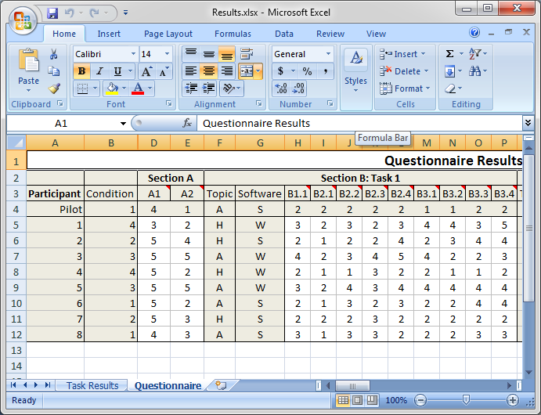
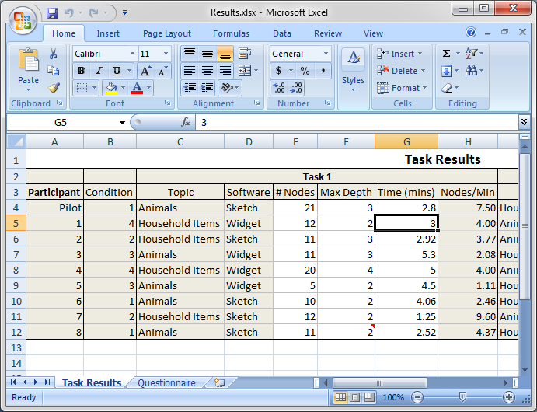

Slide 25
A Note on usability testing research projects
Research tools are usually pushing the boundaries of know interaction – and the software is often buggy
A methodology I suggest is
  If the pilot study revels major flaws fix them immediately
  User test with 4+ participants (max 8, but stop earlier if no new major issues show up with last two participants)
  Analyse errors and results
  Fix all major errors
  User test again (using the same tasks, etc) with another 4-6 participants

Slide 26
An example (Euler diagram tool)
Problems | Total | Test 01 | Test 02 | Test 03 | Test 04 | Test 05 | Test 06 | Test 07 | fix issues and bugs | Test 08 | Test 09 | Test 10 | Test 11 | Test 12
Formal: Try to add/edit letters after creating a shape | 3 | 1 |  | 1 |  |  | 1
Formal: Try to drag enlarge | 2 | 1 |  |  |  |  |  | 1
Formal: Try to delete shapes in select mode | 3 |  | 1 | 1 | 1
Formal: Try to draw a shape instead of a single-click | 2 |  |  |  | 1 |  |  | 1
Formal: Expect to stretch circles in 4 directions | 1 | 1
Formal: Look for a way to cancel a shape when creating | 1 |  | 1
Formal: Try to sketch a letter in formal | 1 |  |  |  |  |  |  | 1
Formal: Click on the top left corner for rotation |  |  |  |  |  |  |  |  |  | 1
Formal: Hard to handle the angle of rotation |  |  |  |  |  |  |  |  |  |  |  |  | 1 | 1
Sketch: Drag move before selecting |  |  |  |  |  |  |  |  |  |  |  | 1 | 1
Both: Try to move the letters seperately | 3 | 1 | 1 |  | 1
Both: Expect the position of pencil button to be the first | 2 | 1 |  |  | 1
Both: The purposes of buttons are not clear enough | 2 | 1 | 1
Both: Expect the default mode to be pencil | 1 | 1
Both: Ask for built-in samples | 1 | 1
Both: Indicator of processing is required | 4 |  | 1 |  | 1 |  | 1 | 1
Both: The default distance between shape and label is too short | 3 |  |  |  | 1 | 1 |  | 1
Both: Try to delete a shape by clicking on the area not the edge | 3 | 1 |  |  | 1 | 1 |  | 1
Both: The instruction of "new graph" button is too long | 4 | 1 |  | 1 |  | 1 | 1
Bugs:
Both: Unrecognised stroke doesnot work with undo/redo | 1 |  | 1
Sketch: Error message when switching selection between shapes | 1 |  | 1
Both: "File is protected" error message when saving a file | 2 |  |  |  | 1 | 1
Both: Duplicate letter are not properly handled | 2 | 1 | 1

Slide 27
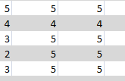
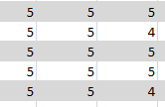
Survey results
Much higher results
Mixed satisfaction
Questionnaire | 5: Strongly Agee |  | 3: Neutral |  | 1: Strongly Disagree
Information: | Test 01 | Test 02 | Test 03 | Test 04 | Test 05 | Test 06 | Test 07 |  | Test08 | Test09 | Test10 | Test11 | Test12 |  | Average | SD
Gender | F | M | M | F | M | M | M |  | F | M | M | F | M
Age | 28 |  |  | 25 | 26 | 29 | 26 |  |  |  | 29 |  | 25
Maojr | Business | CS | CS | CS | Infosys | Infosys | Management |  | CS | CS | Commerce | Public Health | CS
Computer tools | 1/week | < 1/month | 1/month | <1/month | > 2/week | <1/month | <1/month |  | <1/month | Never | <1/month | <1/month | <1/month
Sketching tools | 1/week | Never | Never | <1/month | Never | Never | <1/month |  | <1/month | Never | <1/month | <1/month | Never
Tablet PC | Never | Never | Couple of times | Never | Couple of times | Occasionally | Never |  | Occasionally | Never | Once | Never | Couple of times
Sketch:
Understand the tasks | 4 | 5 | 5 | 5 | 5 | 5 | 5 |  | 5 | 5 | 5 | 5 | 5 |  | 4.92 | 0.29
Easy to find buttons | 3 | 5 | 4 | 5 | 4 | 4 | 5 |  | 5 | 5 | 4 | 5 | 5 |  | 4.50 | 0.67
Easy to create | 3 | 5 | 4 | 5 | 4 | 4 | 5 |  | 5 | 5 | 4 | 5 | 5 |  | 4.50 | 0.67
Easy to edit | 3 | 5 | 4 | 5 | 4 | 3 | 4 |  | 5 | 5 | 3 | 5 | 5 |  | 4.25 | 0.87
Overall easy | 3 | 5 | 4 | 5 | 3 | 4 | 5 |  | 5 | 5 | 4 | 5 | 5 |  | 4.42 | 0.79
Formal:
Understand the tasks | 5 | 5 | 5 | 5 | 5 | 5 | 5 |  | 5 | 5 | 5 | 5 | 5 |  | 5.00 | 0.00
Easy to find buttons | 4 | 4 | 4 | 5 | 4 | 5 | 5 |  | 5 | 5 | 5 | 5 | 5 |  | 4.67 | 0.49
Easy to create | 3 | 5 | 5 | 5 | 4 | 5 | 4 |  | 5 | 5 | 5 | 5 | 5 |  | 4.67 | 0.65
Easy to edit | 2 | 5 | 5 | 5 | 4 | 5 | 5 |  | 5 | 5 | 5 | 5 | 4 |  | 4.58 | 0.90
Overall easy | 3 | 5 | 5 | 5 | 3 | 5 | 5 |  | 5 | 5 | 5 | 5 | 5 |  | 4.67 | 0.78
Switching:
Understand the tasks | 4 | 5 | 5 | 5 | 5 | 5 | 5 |  | 5 | 5 | 5 | 5 | 5 |  | 4.92 | 0.29
Easy to find buttons | 3 | 5 | 4 | 5 | 5 | 5 | 5 |  | 5 | 5 | 4 | 5 | 5 |  | 4.67 | 0.65
Easy to create | 3 | 5 | 5 | 4 | 3 | 5 | 5 |  | 5 | 5 | 5 | 5 | 5 |  | 4.58 | 0.79
Easy to edit | 3 | 5 | 5 | 5 | 5 | 5 | 4 |  | 5 | 5 | 5 | 5 | 5 |  | 4.75 | 0.62
Overall easy | 3 | 5 | 5 | 5 | 4 | 5 | 5 |  | 5 | 5 | 4 | 5 | 5 |  | 4.67 | 0.65
General:
Satisfied with amount of time | 5 | 5 | 5 | 5 | 4 | 5 | 5 |  | 5 | 5 | 5 | 5 | 5 |  | 4.92 | 0.29
Satisfied with ease of completing | 4 | 5 | 5 | 3 | 4 | 4 | 5 |  | 5 | 5 | 5 | 5 | 5 |  | 4.58 | 0.67
Conversion of shape is accurate | 2 | 5 | 5 | 5 | 4 | 4 | 5 |  | 5 | 5 | 5 | 5 | 4 |  | 4.50 | 0.90
Conversion of text is accurate | 3 | 5 | 5 | 5 | 4 | 4 | 5 |  | 5 | 5 | 4 | 5 | 5 |  | 4.58 | 0.67
Would like to use again | 2 | 5 | 4 | 5 | 4 | 5 | 4 |  | 4 | 5 | 5 | 5 | 5 |  | 4.42 | 0.90
Preferred interface (drawing) | Either | Either | Sketch | Formal | Formal | Sketch | Sketch |  | Sketch | Sketch | Either | Sketch | Formal
Preferred interface (editing) | Either | Formal | Sketch | Either | Either | Either | Formal |  | Formal | Sketch | Formal | Either | Formal
Preferred interface (visualizing) | Either | Sketch | Sketch | Formal | Formal | Formal | Formal |  | Either | Sketch | Sketch | Formal | Either

Slide 28
Statistical Analysis
Simple means, medians, standard deviations, etc, are not usually sufficient – especially for comparative studies.
Need to know some basic statistical concepts:
  Statistical significance: the probability that a given result is due to a real effect and not ‘noise’ in the data.
  Alpha (α) level: the cut-off significance level you are prepared to accept as ‘real’ (usually 0.05).

Slide 29
Statistical Analysis
There are many different types of tests.
  t-test: describes the significance of the difference between two means.
  ANOVA (analysis of variance): describes the significance of any differences between several means.
  Chi square: describes the significance of the difference between categorical variables.

Slide 30
Statistical Analysis
The test you use will depends on the type of study and analysis.
  t-test: many usability studies
  ANOVA: almost all comparative studies
  Chi square: some questionnaire items
You’ll need to read about these before you do them – they all have assumptions that need to be met.

Slide 31
Statistical Analysis
Example of a t-test:
  Our α level = 0.05.
  Males (N=20) score average 56% on a particular test.
  Females (N=25) score 60% on the same test.
  Run an independent samples t test and find that the significance level is 0.07.
  This is not a statistically significant result.

Slide 32
Statistical Analysis
Don’t data mine!
  i.e. run every possible combination of tests and see which ones come out with a result you like.
  This is very dodgy.
  Know what you will be looking for ahead of time.

Slide 33
Statistical Analysis
Good statistics do not make up for bad study design!
  Choose participants wisely.
  Specify exactly what you will measure.
  Be consistent in how you deal with all participants and how you look at their data.
    Get someone else to check (or independently code) if you’re worried.
  Use the right statistical test for the problem – ask someone for help if you’re in doubt.

Slide 34
Reporting
How do you write up your study method and results?
Method Section
Participants
Apparatus
Procedure
  Pre-Test Familiarisation
  Screening
  Questionnaire
  Testing
Results Section
“Data were analysed using [test]...”
Report the exact test used, the p value,
the test statistics (t, F, χ², etc).
There are particular ways you report
the statistics – check these.

Slide 35
Reporting
Type of test used
Experimental data were analysed using a series of 2x2x2 factorial analyses of variance for factors software (sketch or widget), task (‘animals’ or ‘household items’) and order (1 or 2 – the order in which the participant performed the task).
For the ‘household items’ task, the mean number of nodes was significantly higher (F_{(1,8)}=8.895, p=.018) for the widget software condition (mean 19.25 nodes) than the sketch software condition (mean 9.75 nodes).
Specific results, in ANOVA format, for one task

Slide 36
One Last Point
Don’t be scared!
Evaluation studies (particularly user studies) look difficult, but as long as you plan them well, they’re really not that bad.

